Slide 1

Linux Device Drivers
Lection 2
Roman Okhrimenko 2019

Slide 2
Questions to answer on this lection
1. What is Linux Device Model?
2. How kobject, kset, ktype and other k’s implemented?
3. Udev service made possible by uevent, that easy? (not really)
4. Is it my job to handle a concurrency in kernel?
5. What synchronization mechanisms exist in kernel?
6. What type of synchronization should I use?
7. How do I implement interrupt handler for my driver?

Slide 3
What is Linux Device Model?
It is an improved way of representation for system hardware layout and its dependencies.
Was developed to ease power system description, as it is highly hierarchical.
Defines a kind of ”abstract class” for device description and following object-oriented model.
Linux kernel exposes all the devices, drivers, buses in the exact hierarchy in which they exist physically in the system through sysfs
Facilitates ref counting, hot plug support, device classes and more

Slide 4
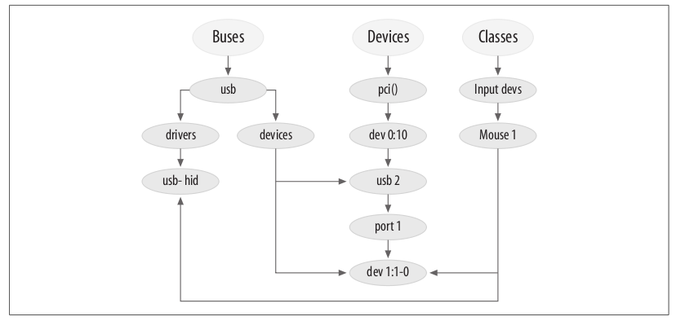
What is Linux Device Model?

Slide 5
kobject, kset, ktype and other k’s
Kobject
Serves as base data structure to implement device model
Entry is created in sysfs for each declared Kobject
May belong to only one subsystem and a subsystem must contain only identically embedded Kobjects
Implements ref counting for its attributes via dentry’s d_fsdata and kref, support classic put(), get() methods to interact
Should link itself to corresponding struct kobj_type

Slide 6
kobject, ktype, kset and other k’s
Ktype
Describes default behavior for a family of kobjects
Kobjects of the same “type” point at the same ktype structure
Declares release method for its kobjects to deconstruct entries when kobjects refs count become zero
Defines sysfs_ops and default_attrs same for related kojects
static struct kobj_type fw_cfg_sysfs_entry_ktype = {
.default_attrs = fw_cfg_sysfs_entry_attrs,
.sysfs_ops = &fw_cfg_sysfs_attr_ops,
.release = fw_cfg_sysfs_release_entry,
};

Slide 7
kobject, ktype, kset and other k’s
Kset
Aggregates collections of kobjects into single place, like bus in /sys/bus – groups all buses in system
Unlike kobj_type only groups kobject in logical subsets and not share functionality
struct kset {
struct list_head list; // list of linked kobjects
spinlock_t list_lock; // spinlock protecting linked list
struct kobject kobj; // base kobject representing this set
const struct kset_uevent_ops *uevent_ops; // points to structure that // describes hotplug behavior
} __randomize_layout;

Slide 8
kobject, ktype, kset and other k’s
Kobject_attribute
Represented as file in sysfs unlike all other k’s
Implements show and store methods to interact with it
Modes and levels of access should be defined as for other files
Use __ATTR macro to set attributes and specify r/w mode
Follow by defining struct attribute and struct attribute_group to pass to sysfs set up routines
There are also binary_attributes

Slide 9
kobject, ktype, kset and other k’s
k’s have self explanatory API
kobject_add(struct kobject *kobj, struct kobject *parent ...);
kobject_del(struct kobject *kobj);
kobject_put(struct kobject *kobj);
struct kset * kset_create_and_add(const char *name, ...);
struct kobj_type *get_ktype(struct kobject *kobj)

Slide 10
kobject, ktype, kset and other k’s
Uevents – user events
Uevents pushed to user space via netlink – a high speed multicast socket used in Linux for IPC on kernel and user space
User space app can easily get uevents by waiting on socket
Udev system service uses this mechanism on startup to create dynamic device directory and populate /dev with devices that are actually detected

Slide 11
Concurrency in kernel
Pics by Alexander Shevchenko of GlobalLogic

Slide 12
Ways of handling concurrency in kernel
Mechanism | Description | Scope
Atomic operations | One cycle read-modify-write instructions | All CPUs
Memory barrier | Avoiding instructions reordering | Local
Spin lock | Lock with busy wait (R/W spins locks) | All CPUs
Semaphore | Lock with blocking wait (R/W semaphores) | All CPUs
Local int disable | Forbid handling of interrupts | Local
Local softirq disable | Forbid deferrable function handling | Local
Global irq disable | Forbid interrupt and softirq handling | All CPUs

Slide 13
Atomic operations
Machine instructions that make 0 or 1 aligned memory access
Read-modify-write type of instructions
Locks the memory bus
Implementation is architecture dependent
Linux provides wrappers for these operations
Defined in arc/arm/include/asm/atomic.h
Some API:
atomic_read(i)
atomic_set(v,i)
atomic_fetch_add_unless(atomic_t *v, int a, int u)
atomic64_cmpxchg_relaxed(atomic64_t *ptr, long long old, long long new)
Very effective for its purpose.

Slide 14
Memory barriers
Compiler do its optimizations like reorders memory accesses
Basically says compiler more about context of following operations
Architecture dependent
Defined in arc/arm/include/asm/barrier.h
Some API:
mb() – memory barrier
rmb() – read memory barrier
wmb() – write memory barrier
and so on
Very effective for its purpose
May lead to less optimal code but more reliable

Slide 15
Spin locks
May be used in code that cannot sleep, such as interrupt handlers
Basically while(get(lock) != 1){ __nop; }
Architecture dependent
Defined in arc/arm/include/asm/spinlock.h
Some API:
arch_spin_lock(arch_spinlock_t * lock)
arch_spin_trylock(arch_spinlock_t *lock)
arch_read_lock(arch_rwlock_t *lock)
arch_write_lock(arch_rwlock_t *lock)
Crucial mechanism on MP and preemptive single processor systems
Offers higher performance then semaphores

Slide 16
Semaphores/mutexes
Thread level of synchronization routine
Suspends a process thus not usable in INT handlers and deferrable functions
When used for mutual exclusion becomes mutexes – which is a most common case in kernel
Example API:
void sema_init(struct semaphore *sem, int val)
void down (struct semaphore *sem);
int down_interruptible(struct semaphore *sem);
int down_trylock(struct semaphore *sem);
void up (struct semaphore *sem);
There are read/write semaphores – rare in derivers though
Allows multiple readers. Queues waiters, so it is fair to writers

Slide 17
Disabling IRQs
Local:
Effective on current CPU
Fast to execute – one ASM instruction
Need to remember state to restore it after routine
Disable software IRQ:
Seems self explanatory
There is an implementation in kernel for software IRQs – high priority, but not as hardware INTs
Globally:
Effective on all CPUs in system
Costly for system
Only for highly critical operations like hardware resource allocations

Slide 18
Critical sections
Short
- disable interrupts (& grab spin lock on MPs)
Long
- implemented in 2 parts – top half and bottom half
- top is a short critical section
- bottom – implements heavy part of critical section
On one processor system uni-processor no sync required
On multiprocessor need to use a lock to protect data structures from concurrent access

Slide 19
Handling interrupts
Tasklet
- deffered type of handling
tasklets are atomic, so we cannot use sleep()
consists of 2 parts – bottom and top
executed in same context as softirqs
Workqueue
- deffered type of handling
can sleep() as executed in process context
can use mutexes
powerful mechanism for heavy and time consuming handlers
user worker threads mechanism to support async execution
can be bound or unbound to CPU

Slide 20
References
https://bootlin.com/doc/training/linux-kernel/
https://linux-kernel-labs.github.io/master/lectures/intro.html
https://www.kernel.org/doc/html/latest/filesystems/vfs.html
https://www.ibm.com/developerworks/ru/library/l-linux_kernel_01/index.html
http://www.opensourceforu.com/2011/02/linux-character-drivers
https://www.thegeekdiary.com/understanding-the-sysfs-file-system-in-linux/
https://medium.com/@nayangadre/the-kernel-kobject-device-model-explained-89d02350fa03
http://www.cs.utexas.edu/~witchel/372/lectures
https://static.lwn.net/images/pdf/LDD3/ch05.pdf

